Slide 1





Slide 3


Slide 4


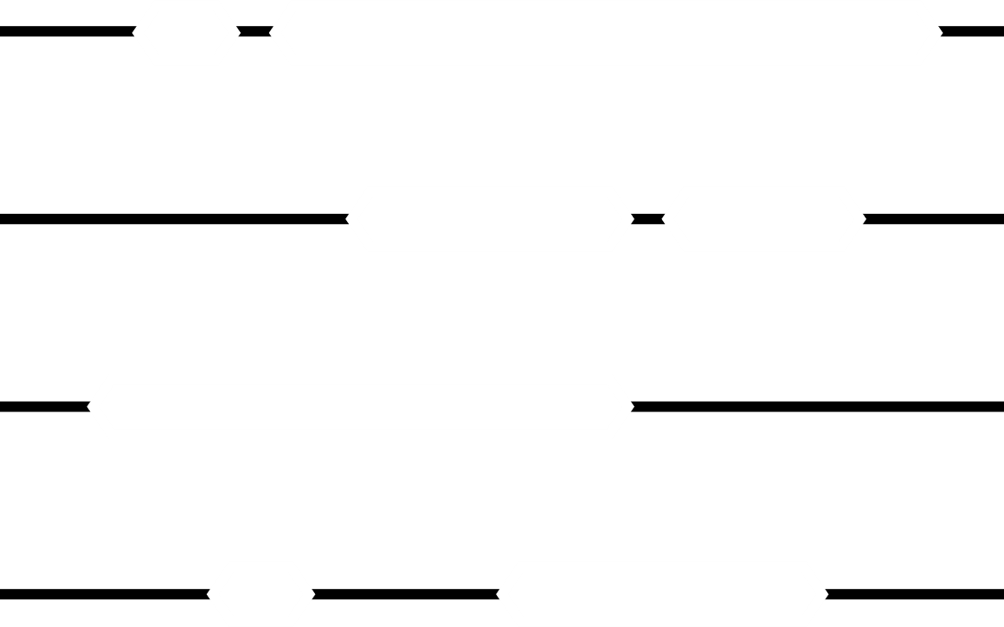
Project X application

Slide 5

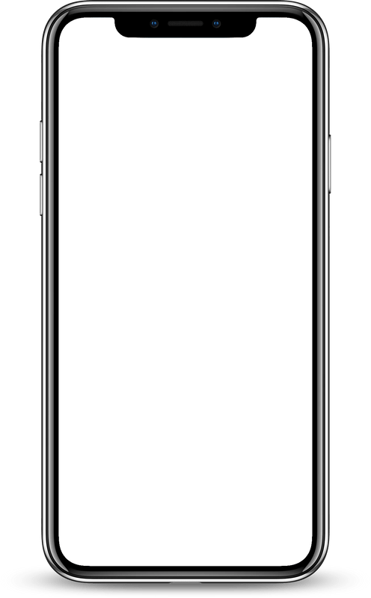
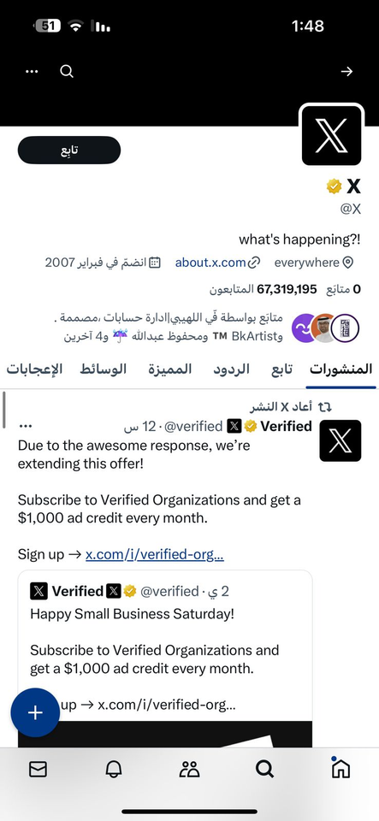

Kingdome of Saudi Arabia
Ministry of Education
Prince Sattam Bin Abdulaziz University College of Computer
Engineering and Science
المملكة العربية السعودية
وزارة التعليم
جامعة الأمير سطام بن عبد العزيز
كلية هندسة وعلوم الحاسب
Project X application
N
1
2
3
4
Student Name
Student Number
Alanoud Abdullah Saad Al-sager
Taghreed Saeed Saad Alzuayr
Bushra Murdhi Mohammed Alhabshan
Shikhah Saud Abdullah Alrashoud
443850313
443850326
443850234
443850295
Supervised by: Dr. Mohammed Saad Mohammed Asiri. Year: 2023.

Slide 6

INTRODUCTION:
In this report , we will talk about the application X, and the importance of this research lies in studying the application X by applying software engineering principles to it and exploring its objectives and development process.

Slide 7
INTRODUCTION:
In this report , we will talk about the application X, and the importance of this research lies in studying the application X by applying software engineering principles to it and exploring its objectives and development process.

Slide 8


BACKGROUND:
Twitter was created in 2006 by founder "Jack Dorsey" and has achieved great success over the years and in 2022 Following "Elon Musk’s" takeover of the app, it has been renamed from ‘Twitter’ to ‘X’ and other related changes were implemented
WORK PLAN
Methodology : incremental development

Slide 9
PURPOSE OF THE PROJECT
Explain the software
engineering steps to build the X app
WORK PLAN
WORK PLAN:
Methodology : incremental development

Slide 10


WORK PLAN
Methodology : incremental development

Slide 11
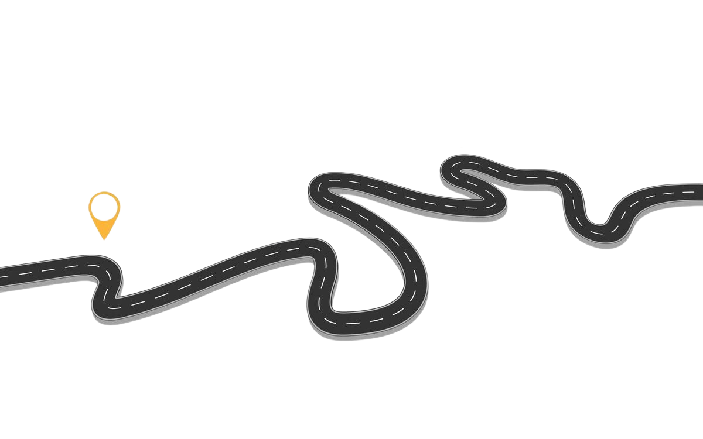

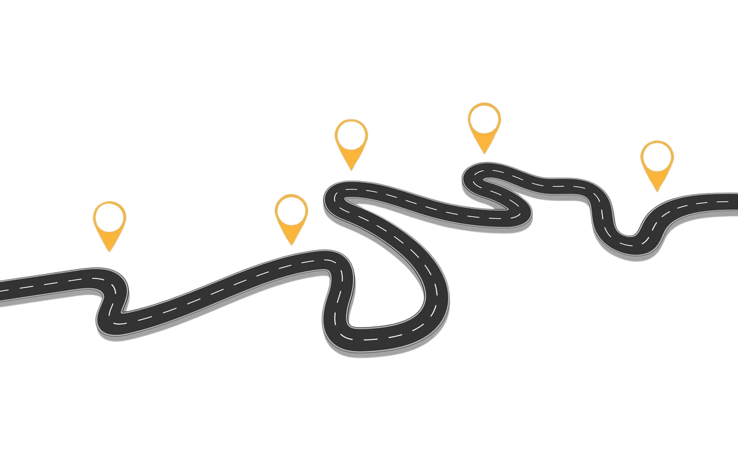







WORK PLAN
Methodology : incremental development
1)Planning :
Market study, specify the goal of the application, specify the scope of the product, calculate the cost and budget, product development time, product potential risk, product and the size of the project and the team size. and determine the programming language.
2)Specification :
Defining what the system should do functionally and non-functionally, covering all the needs of the user and what is truly expected from the system, make a use case diagram.
5) Validation :
Testing the unit, testing the integration, testing the entire system, acceptance testing 'testing the final system'.
7) Evolution :
Add more features based on the stakeholders needs.
4) Implementation :
Installing the design into an existing program, setting up software components and orienting users.
3) Design :
Designing a software structure that meets the specification, and it contains: wire-framing, user stories, data flow diagram, technical design, user interface.
6) Testing :
Checking it satisfied user expectations and needs, stakeholders must see the reports to check if an application works as expected.
8) :Maintenance: It is a continuous process for bug fixing or improving existing features and this process must be done every month due to the large size of the app

Slide 12
WORK PLAN
Methodology : incremental development
1)Planning :
Market study, specify the goal of the application, specify the scope of the product, calculate the cost and budget, product development time, product potential risk, product the size of the project and the team size. and determine the programming language.
3) Design :
Designing a software structure that meets the specification, and it contains: wire-framing, user stories, data flow diagram, technical design, user interface.
7) Evolution :
Add more features based on the stakeholders needs.
4) Implementation :
Installing the design into an existing program, setting up software components and orienting users.
2)Specification :
Defining what the system should do functionally and non-functionally, covering all the needs of the user and what is truly expected from the system, make a use case diagram.
6) Testing :
Checking it satisfied user expectations and needs, stakeholders must see the reports to check if an application works as expected.
8) :Maintenance: It is a continuous process for bug fixing or improving existing features and this process must be done every month due to the large size of the app

Slide 13
WORK PLAN
5) Validation :
Checking it satisfied user expectations and needs, stakeholders must see the reports to check if an application works as expected
Methodology : incremental development
1)Planning :
Market study, specify the goal of the application, specify the scope of the product, calculate the cost and budget, product development time, product potential risk, product and the size of the project and the team size. and determine the programming language.
2)Specification :
Defining what the system should do functionally and non-functionally, covering all the needs of the user and what is truly expected from the system, make a use case diagram.
7) Evolution :
Add more features based on the stakeholders needs.
6) Testing :
Identify the testing goals and the test input, write test scenarios for a given feature and compute the expected scenarios with the selected input values, turn the test scenario into a test case then run and execute the test case, finally compare actual outcomes against expected results
4) Implementation :
Installing the design into an existing program, setting up software components and orienting users.
3) Design :
Designing a software structure that meets the specification, and it contains: wire-framing, user stories, data flow diagram, technical design, user interface.
8) Maintenance: It is a continuous process for bug fixing or improving existing features and this process must be done every month due to the large size of the app
8) :Maintenance: It is a continuous process for bug fixing or improving existing features and this process must be done every month due to the large size of the app

Slide 14


WORK PLAN
Methodology : incremental development
FUNCTIONAL & NON FUNCTIONAL REQUIREMENTS
Functional Requirements:
5- Search:
The premium and registered user should be able to search for other users' accounts by their unique username ,or posts, using the search bar, and they can search multiple time .
6- Interaction:
The premium and registered user should be able to interact with other users ( e.g: likes, repost, mention, or comment )
7- Bookmark:
The premium and registered user should be able to bookmark posts and access them privately.
8- Direct Messages:
Users should have message options to use, such as text, photo, video, GIF and voice recording.
1- Account:
The user should be able to create an account using a phone number or email address، username and date of birth to access the application.
2- Deletion:
The user should be able to delete and remove the account after registration.
3- Posting:
The premium and register users should be able to post, quote post, mention, comment and it may include text, images, videos , GIF and audio recordings.
4- Follow or Unfollow:
The premium and registered user should be able to follow other users’ accounts or unfollow them, and they can follow them by their unique username, every account has a followers list and a following list.
1)Planning :
Market study, specify the goal of the application, specify the scope of the product, calculate cost and budget, product development time, product potential risk, product the size of the project and the team size.
5)Implementation :
Installing the design into an existing program
2)Specification :
Defining what the system should do functionally and non-functionally, covering all the needs of the user.
7)Testing :
Unit testing , integration testing , system testing, acceptance testing.
4)Design :
Design a software structure that realises the specification
3)Development :
Determine the programming language, tools and framework to build a software solutions that meets the specification.
6)Validation :
Checking it satisfied user expectations and needs and conforms to its specification.
8)Evolution :
Add more features based on the stakeholders needs.

Slide 15
WORK PLAN
Methodology : incremental development
FUNCTIONAL & NON FUNCTIONAL REQUIREMENTS
Functional Requirements:
1- Account:
The user should be able to create an account using a phone number or email address، username and date of birth to access the application.
3- Posting:
The premium and register users should be able to post, quote post, mention, comment and it may include text, images, videos , GIF and audio recordings.
4- Follow or Unfollow:
The premium and registered user should be able to follow other users’ accounts or unfollow them, and they can follow them by their unique username, every account has a followers list and a following list.
5- Search:
The premium and registered user should be able to search for other users' accounts by their unique username ,or posts, using the search bar, and they can search multiple time .
6- Interaction:
The premium and registered user should be able to interact with other users ( e.g: likes, repost, mention, or comment )
7- Bookmark:
The premium and registered user should be able to bookmark posts and access them privately.
8- Direct Messages:
Users should have message options to use, such as text, photo, video, GIF and voice recording.
2- Deletion:
The user should be able to delete and remove the account after registration.
1)Planning :
Market study, specify the goal of the application, specify the scope of the product, calculate cost and budget, product development time, product potential risk, product the size of the project and the team size.
5)Implementation :
Installing the design into an existing program
2)Specification :
Defining what the system should do functionally and non-functionally, covering all the needs of the user.
7)Testing :
Unit testing , integration testing , system testing, acceptance testing.
4)Design :
Design a software structure that realises the specification
3)Development :
Determine the programming language, tools and framework to build a software solutions that meets the specification.
6)Validation :
Checking it satisfied user expectations and needs and conforms to its specification.
8)Evolution :
Add more features based on the stakeholders needs.

Slide 16
WORK PLAN
Methodology : incremental development
FUNCTIONAL & NON FUNCTIONAL REQUIREMENTS
Functional Requirements:
1- Account:
The user should be able to create an account using a phone number or email address، username and date of birth to access the application.
2- Deletion:
The user should be able to delete and remove the account after registration.
3- Posting:
The premium and register users should be able to post, quote post, mention, comment and it may include text, images, videos , GIF and audio recordings.
4- Follow or Unfollow:
The premium and registered user should be able to follow other users’ accounts or unfollow them, and they can follow them by their unique username, every account has a followers list and a following list.
5- Search:
The premium and registered user should be able to search for other users' accounts by their unique username ,or posts, using the search bar, and they can search multiple time .
6- Interaction:
The premium and registered user should be able to interact with other users ( e.g: likes, repost, mention, or comment )
7- Bookmark:
The premium and registered user should be able to bookmark posts and access them privately.
8- Direct Messages:
Users should have message options to use, such as text, photo, video, GIF and voice recording.
1)Planning :
Market study, specify the goal of the application, specify the scope of the product, calculate cost and budget, product development time, product potential risk, product the size of the project and the team size.
5)Implementation :
Installing the design into an existing program
2)Specification :
Defining what the system should do functionally and non-functionally, covering all the needs of the user.
7)Testing :
Unit testing , integration testing , system testing, acceptance testing.
4)Design :
Design a software structure that realises the specification
3)Development :
Determine the programming language, tools and framework to build a software solutions that meets the specification.
6)Validation :
Checking it satisfied user expectations and needs and conforms to its specification.
8)Evolution :
Add more features based on the stakeholders needs.

Slide 17
WORK PLAN
Methodology : incremental development
FUNCTIONAL & NON FUNCTIONAL REQUIREMENTS
Functional Requirements:
1- Account:
The user should be able to create an account using a phone number or email address، username and date of birth to access the application.
2- Deletion:
The user should be able to delete and remove the account after registration.
3- Posting:
The premium and register users should be able to post, quote post, mention, comment and it may include text, images, videos , GIF and audio recordings.
4- Follow or Unfollow:
The premium and registered user should be able to follow other users’ accounts or unfollow them, and they can follow them by their unique username, every account has a followers list and a following list.
5- Search:
The premium and registered user should be able to search for other users' accounts by their unique username ,or posts, using the search bar, and they can search multiple time .
6- Interaction:
The premium and registered user should be able to interact with other users ( e.g: likes, repost, mention, or comment )
7- Bookmark:
The premium and registered user should be able to bookmark posts and access them privately.
8- Direct Messages:
Users should have message options to use, such as text, photo, video, GIF and voice recording.
1)Planning :
Market study, specify the goal of the application, specify the scope of the product, calculate cost and budget, product development time, product potential risk, product the size of the project and the team size.
5)Implementation :
Installing the design into an existing program
2)Specification :
Defining what the system should do functionally and non-functionally, covering all the needs of the user.
7)Testing :
Unit testing , integration testing , system testing, acceptance testing.
4)Design :
Design a software structure that realises the specification
3)Development :
Determine the programming language, tools and framework to build a software solutions that meets the specification.
6)Validation :
Checking it satisfied user expectations and needs and conforms to its specification.
8)Evolution :
Add more features based on the stakeholders needs.

Slide 18
WORK PLAN
Methodology : incremental development
FUNCTIONAL & NON FUNCTIONAL REQUIREMENTS
Functional Requirements:
1- Account:
The user should be able to create an account using a phone number or email address، username and date of birth to access the application.
2- Deletion:
The user should be able to delete and remove the account after registration.
3- Posting:
The premium and register users should be able to post, quote post, mention, comment and it may include text, images, videos , GIF and audio recordings.
4- Follow or Unfollow:
The premium and registered user should be able to follow other users’ accounts or unfollow them, and they can follow them by their unique username, every account has a followers list and a following list.
6- Interaction:
The premium and registered user should be able to interact with other users ( e.g: likes, repost, mention, or comment )
7- Bookmark:
The premium and registered user should be able to bookmark posts and access them privately.
8- Direct Messages:
Users should have message options to use, such as text, photo, video, GIF and voice recording.
5- Search:
The premium and registered user should be able to search for other users' accounts by their unique username ,or posts, using the search bar, and they can search multiple time .
1)Planning :
Market study, specify the goal of the application, specify the scope of the product, calculate cost and budget, product development time, product potential risk, product the size of the project and the team size.
5)Implementation :
Installing the design into an existing program
2)Specification :
Defining what the system should do functionally and non-functionally, covering all the needs of the user.
7)Testing :
Unit testing , integration testing , system testing, acceptance testing.
4)Design :
Design a software structure that realises the specification
3)Development :
Determine the programming language, tools and framework to build a software solutions that meets the specification.
6)Validation :
Checking it satisfied user expectations and needs and conforms to its specification.
8)Evolution :
Add more features based on the stakeholders needs.

Slide 19
WORK PLAN
Methodology : incremental development
FUNCTIONAL & NON FUNCTIONAL REQUIREMENTS
Functional Requirements:
1- Account:
The user should be able to create an account using a phone number or email address، username and date of birth to access the application.
2- Deletion:
The user should be able to delete and remove the account after registration.
3- Posting:
The premium and register users should be able to post, quote post, mention, comment and it may include text, images, videos , GIF and audio recordings.
4- Follow or Unfollow:
The premium and registered user should be able to follow other users’ accounts or unfollow them, and they can follow them by their unique username, every account has a followers list and a following list.
6- Interaction:
The premium and registered user should be able to interact with other users ( e.g: likes, repost, mention, or comment )
7- Bookmark:
The premium and registered user should be able to bookmark posts and access them privately.
8- Direct Messages:
Users should have message options to use, such as text, photo, video, GIF and voice recording.
5- Search:
The premium and registered user should be able to search for other users' accounts by their unique username ,or posts, using the search bar, and they can search multiple time .
1)Planning :
Market study, specify the goal of the application, specify the scope of the product, calculate cost and budget, product development time, product potential risk, product the size of the project and the team size.
5)Implementation :
Installing the design into an existing program
2)Specification :
Defining what the system should do functionally and non-functionally, covering all the needs of the user.
7)Testing :
Unit testing , integration testing , system testing, acceptance testing.
4)Design :
Design a software structure that realises the specification
3)Development :
Determine the programming language, tools and framework to build a software solutions that meets the specification.
6)Validation :
Checking it satisfied user expectations and needs and conforms to its specification.
8)Evolution :
Add more features based on the stakeholders needs.

Slide 20
WORK PLAN
Methodology : incremental development
FUNCTIONAL & NON FUNCTIONAL REQUIREMENTS
Functional Requirements:
1- Account:
The user should be able to create an account using a phone number or email address، username and date of birth to access the application.
2- Deletion:
The user should be able to delete and remove the account after registration.
3- Posting:
The premium and register users should be able to post, quote post, mention, comment and it may include text, images, videos , GIF and audio recordings.
4- Follow or Unfollow:
The premium and registered user should be able to follow other users’ accounts or unfollow them, and they can follow them by their unique username, every account has a followers list and a following list.
6- Interaction:
The premium and registered user should be able to interact with other users ( e.g: likes, repost, mention, or comment )
7- Bookmark:
The premium and registered user should be able to bookmark posts and access them privately.
8- Direct Messages:
Users should have message options to use, such as text, photo, video, GIF and voice recording.
5- Search:
The premium and registered user should be able to search for other users' accounts by their unique username ,or posts, using the search bar, and they can search multiple time .
1)Planning :
Market study, specify the goal of the application, specify the scope of the product, calculate cost and budget, product development time, product potential risk, product the size of the project and the team size.
5)Implementation :
Installing the design into an existing program
2)Specification :
Defining what the system should do functionally and non-functionally, covering all the needs of the user.
7)Testing :
Unit testing , integration testing , system testing, acceptance testing.
4)Design :
Design a software structure that realises the specification
3)Development :
Determine the programming language, tools and framework to build a software solutions that meets the specification.
6)Validation :
Checking it satisfied user expectations and needs and conforms to its specification.
8)Evolution :
Add more features based on the stakeholders needs.

Slide 21
WORK PLAN
Methodology : incremental development
FUNCTIONAL & NON FUNCTIONAL REQUIREMENTS
Functional Requirements:
1- Account:
The user should be able to create an account using a phone number or email address، username and date of birth to access the application.
2- Deletion:
The user should be able to delete and remove the account after registration.
3- Posting:
The premium and register users should be able to post, quote post, mention, comment and it may include text, images, videos , GIF and audio recordings.
4- Follow or Unfollow:
The premium and registered user should be able to follow other users’ accounts or unfollow them, and they can follow them by their unique username, every account has a followers list and a following list.
6- Interaction:
The premium and registered user should be able to interact with other users ( e.g: likes, repost, mention, or comment )
7- Bookmark:
The premium and registered user should be able to bookmark posts and access them privately.
8- Direct Messages:
Users should have message options to use, such as text, photo, video, GIF and voice recording.
5- Search:
The premium and registered user should be able to search for other users' accounts by their unique username ,or posts, using the search bar, and they can search multiple time .
1- Account:
The user should be able to create an account using a phone number or email address، username and date of birth to access the application.
2- Deletion:
The user should be able to delete and remove the account after registration.
3- Posting:
The premium and register users should be able to post, quote post, mention, comment and it may include text, images, videos , GIF and audio recordings.
4- Follow or Unfollow:
The premium and registered user should be able to follow other users’ accounts or unfollow them, and they can follow them by their unique username, every account has a followers list and a following list.
1)Planning :
Market study, specify the goal of the application, specify the scope of the product, calculate cost and budget, product development time, product potential risk, product the size of the project and the team size.
5)Implementation :
Installing the design into an existing program
2)Specification :
Defining what the system should do functionally and non-functionally, covering all the needs of the user.
7)Testing :
Unit testing , integration testing , system testing, acceptance testing.
4)Design :
Design a software structure that realises the specification
3)Development :
Determine the programming language, tools and framework to build a software solutions that meets the specification.
6)Validation :
Checking it satisfied user expectations and needs and conforms to its specification.
8)Evolution :
Add more features based on the stakeholders needs.

Slide 22
WORK PLAN
Methodology : incremental development
FUNCTIONAL & NON FUNCTIONAL REQUIREMENTS
Functional Requirements:
1- Account:
The user should be able to create an account using a phone number or email address، username and date of birth to access the application.
2- Deletion:
The user should be able to delete and remove the account after registration.
3- Posting:
The premium and register users should be able to post, quote post, mention, comment and it may include text, images, videos , GIF and audio recordings.
4- Follow or Unfollow:
The premium and registered user should be able to follow other users’ accounts or unfollow them, and they can follow them by their unique username, every account has a followers list and a following list.
1- Account:
The user should be able to create an account using a phone number or email address، username and date of birth to access the application.
2- Deletion:
The user should be able to delete and remove the account after registration.
3- Posting:
The premium and register users should be able to post, quote post, mention, comment and it may include text, images, videos , GIF and audio recordings.
4- Follow or Unfollow:
The premium and registered user should be able to follow other users’ accounts or unfollow them, and they can follow them by their unique username, every account has a followers list and a following list.
5- Search:
The premium and registered user should be able to search for other users' accounts by their unique username ,or posts, using the search bar, and they can search multiple time .
6- Interaction:
The premium and registered user should be able to interact with other users ( e.g: likes, repost, mention, or comment )
7- Bookmark:
The premium and registered user should be able to bookmark posts and access them privately.
8- Direct Messages:
Users should have message options to use, such as text, photo, video, GIF and voice recording.
1)Planning :
Market study, specify the goal of the application, specify the scope of the product, calculate cost and budget, product development time, product potential risk, product the size of the project and the team size.
5)Implementation :
Installing the design into an existing program
2)Specification :
Defining what the system should do functionally and non-functionally, covering all the needs of the user.
7)Testing :
Unit testing , integration testing , system testing, acceptance testing.
4)Design :
Design a software structure that realises the specification
3)Development :
Determine the programming language, tools and framework to build a software solutions that meets the specification.
6)Validation :
Checking it satisfied user expectations and needs and conforms to its specification.
8)Evolution :
Add more features based on the stakeholders needs.

Slide 23







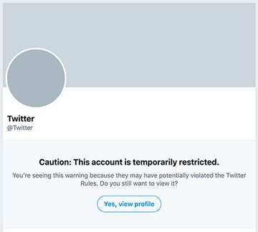
FUNCTIONAL & NON FUNCTIONAL REQUIREMENTS
Non-Functional Requirements:
1- Services must be reliable (e.g., when a posting is successful, it should not be lost).
2- The service should be highly available at any time, so users can send and see posts without interruption.
3- The system should be scalable and accommodate increased load (e.g., an increase in users and postings).
4- The system should implement the provisions for violating the privacy policy or application laws for users as set out by the user's country.

Slide 24
FUNCTIONAL & NON FUNCTIONAL REQUIREMENTS
Non-Functional Requirements:
1- Services must be reliable (e.g., when a posting is successful, it should not be lost).
2- The service should be highly available at any time, so users can send and see posts without interruption.
3- The system should be scalable and accommodate increased load (e.g., an increase in users and postings).
4- The system should implement the provisions for violating the privacy policy or application laws for users as set out by the user's country.

Slide 25
FUNCTIONAL & NON FUNCTIONAL REQUIREMENTS
Non-Functional Requirements:
1- Services must be reliable (e.g., when a posting is successful, it should not be lost).
2- The service should be highly available at any time, so users can send and see posts without interruption.
3- The system should be scalable and accommodate increased load (e.g., an increase in users and postings).
4- The system should implement the provisions for violating the privacy policy or application laws for users as set out by the user's country.

Slide 26

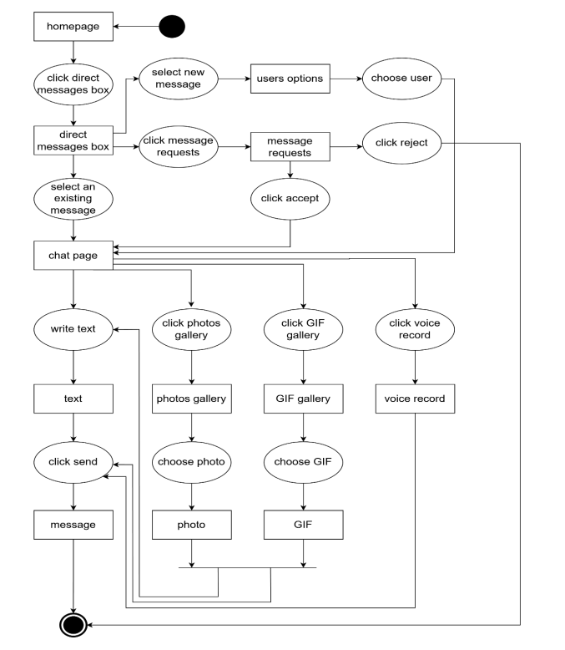


FUNCTIONAL & NON FUNCTIONAL REQUIREMENTS
Non-Functional Requirements:
1- Services must be reliable (e.g., when a posting is successful, it should not be lost).
2- The service should be highly available at any time, so users can send and see posts without interruption.
3- The system should be scalable and accommodate increased load (e.g., an increase in users and postings).
4- The system should implement the provisions for violating the privacy policy or application laws for users as set out by the user's country.

Slide 27


ACTIVITY DIAGRAM:
Describes control, input, and output flows among actions.

Slide 28
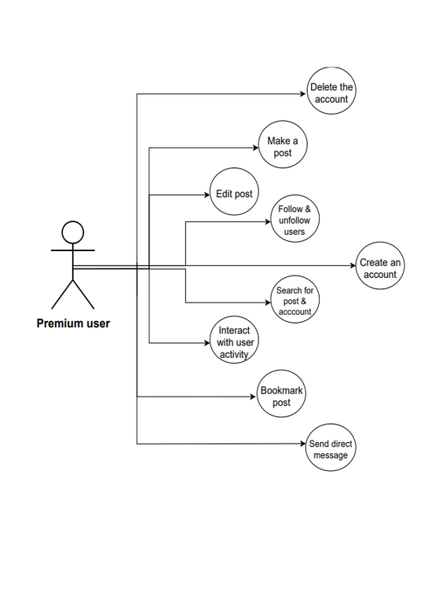
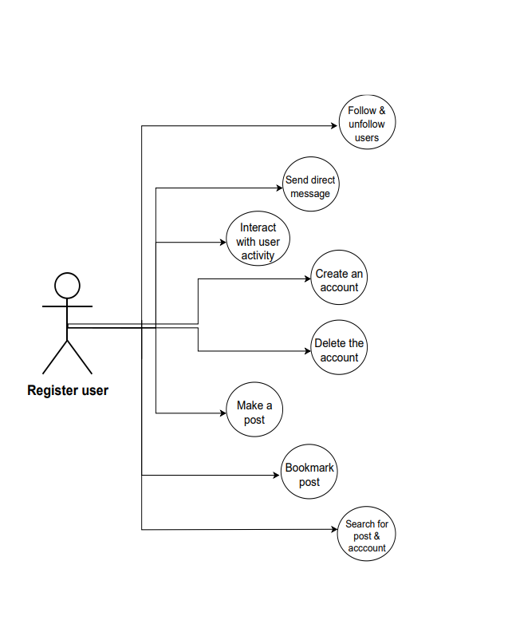
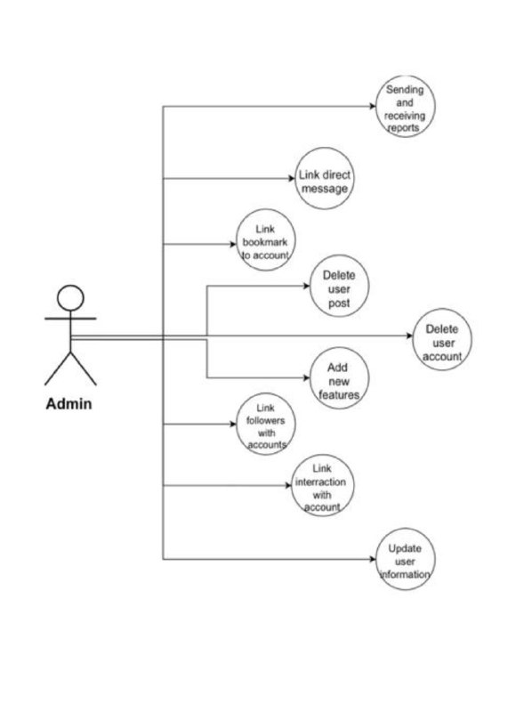
USE CASE MODELING:
description of the ways in which a user interacts with the system.

Slide 29
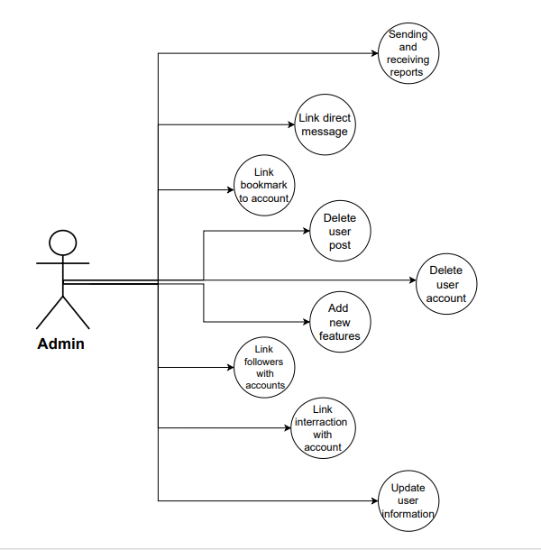
USE CASE MODELING:
description of the ways in which a user interacts with the system.

Slide 30
USE CASE MODELING:
description of the ways in which a user interacts with the system.

Slide 31
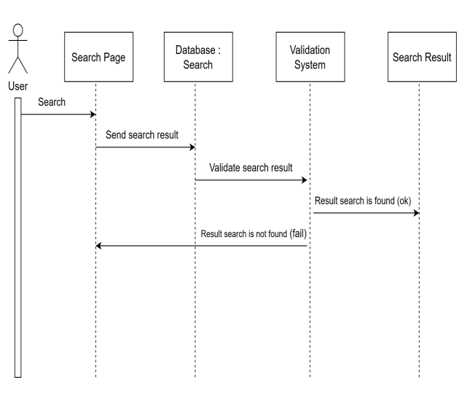
SEQUENCE DIAGRAM:
describe the interaction between elements over a chronological sequence.

Slide 32
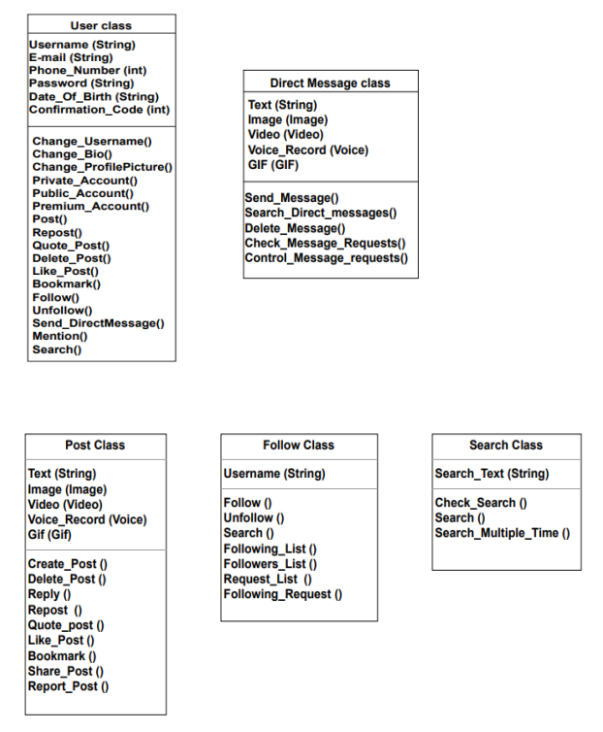
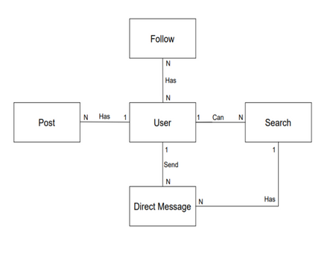
CLASS DIAGRAM:
describes the structure of a system by showing the system's classes, their attributes.

Slide 33
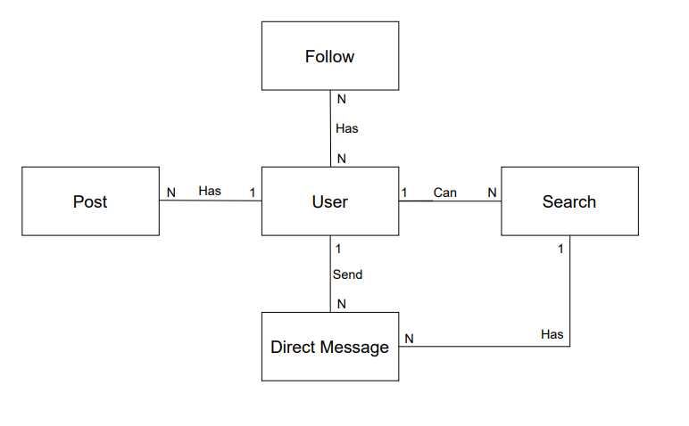
REALATIONSHIP:

Slide 34

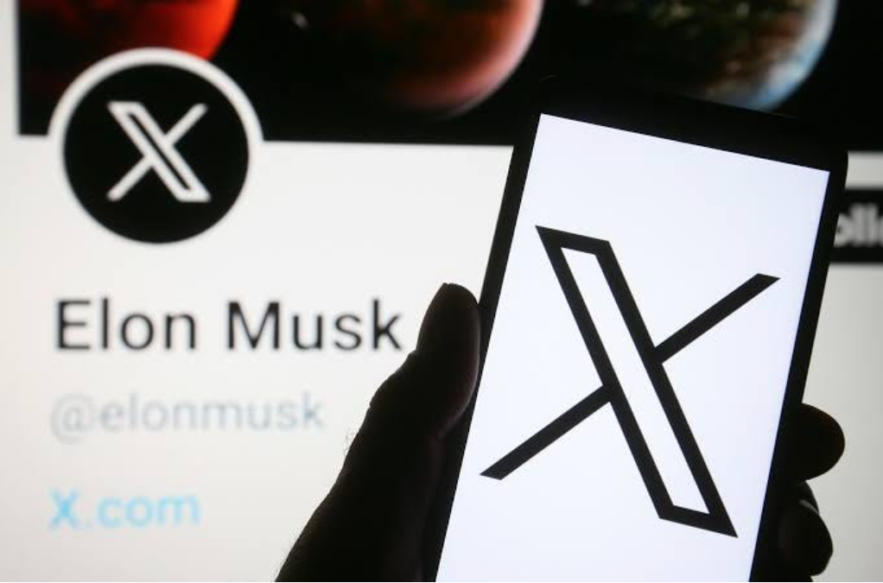


CONCLUSION:
During the study and analysis of the system, the focus was on what makes the application easy to use, effective, and meets the needs of users. As a result of this study, the team was able to determine the necessary steps to build an application X based on what was studied.

